Slide 1
CIS 553 Project 2 Group E
Ankit Mishra
Gouthaman Kumarappan
Simon Wimmer

Slide 2
Problem
Problem – DDoS attack mitigation
Distributed – Multiple attackers target a single victim node.
Denial of Service – Attacker(s) send overwhelming number of ping requests (ping flood) and keep its resources tied.
Result – The victim cannot service its intended users.

Slide 3
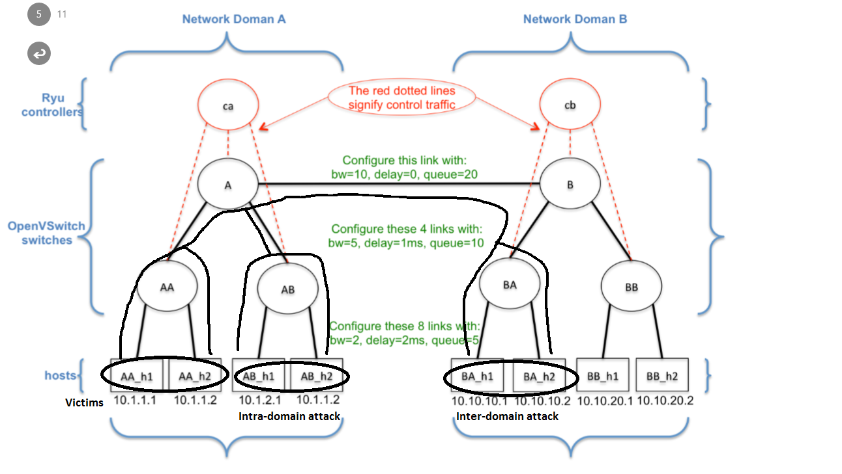
Topology and Attack Overview

Slide 4
Solution Overview
Solution Stages –
Detect an attack
Identify the attacker
If attacker in same domain – Apply Ingress on the switch-attacker link.
If attacker in another domain – Send pushback request to the other domain.
Respond to a pushback request (if detected).

Slide 5
Solution
Identify an Attack –
Controller A protects hosts AAh1 and AAh2 by monitoring flows on all 3 switches under its domain for high bandwidth (5 Mbps).
Identify an Attacker –
Check each host to check if it is sending data to the victim and its data rate is above a threshold (1 Mbps).

Slide 6
Solution
Intra domain attack –
Apply ingress policy on the link connecting the attacker to the domain.
Inter domain attack –
Send a push back request to the other controller.

Slide 7
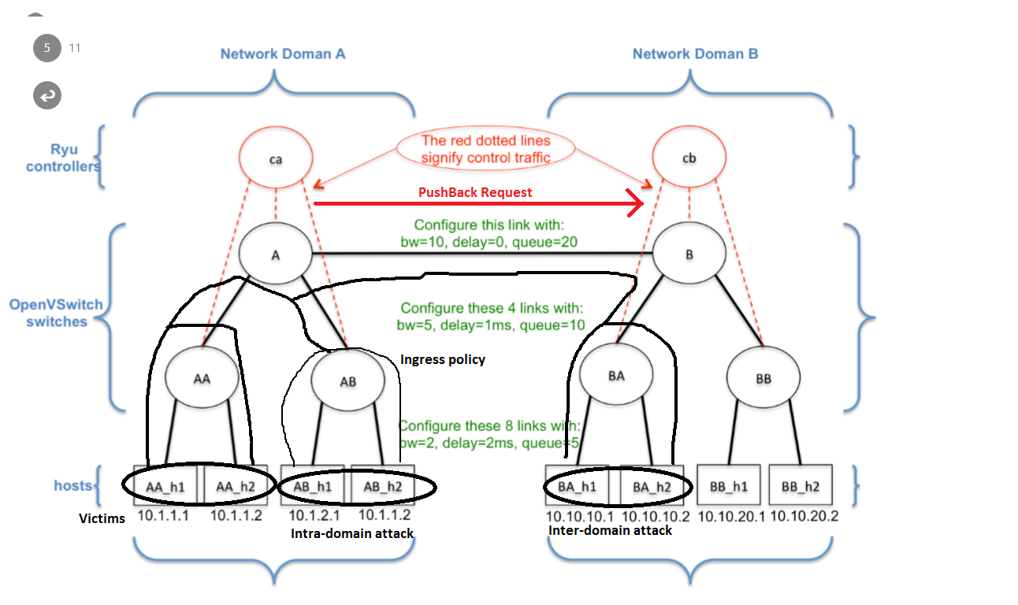
Solution – Intra-domain ingress + inter-domain pushback

Slide 8
Solution
Respond to pushback –
Indentify the attacker.
Place an egress on the switch connecting attacker to the domain.
Wait 10 seconds
Place an ingress at the link connecting the attacker to the domain and remove the egress policy.

Slide 9
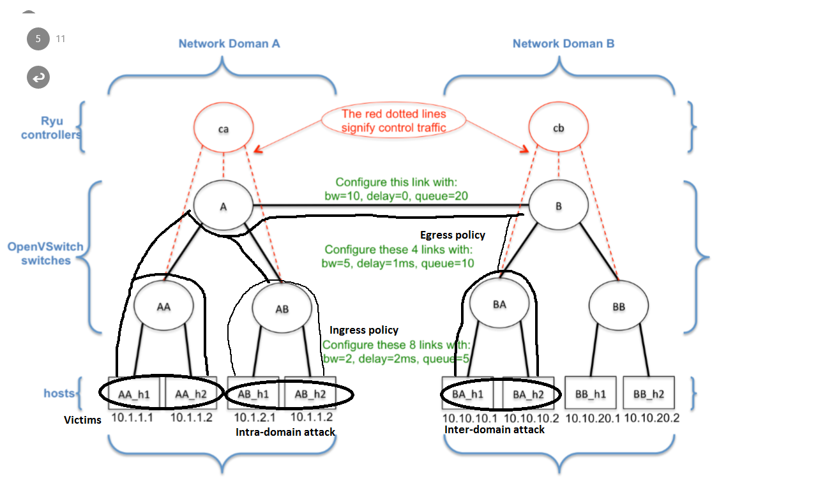
Solution – Egress on pushback

Slide 10
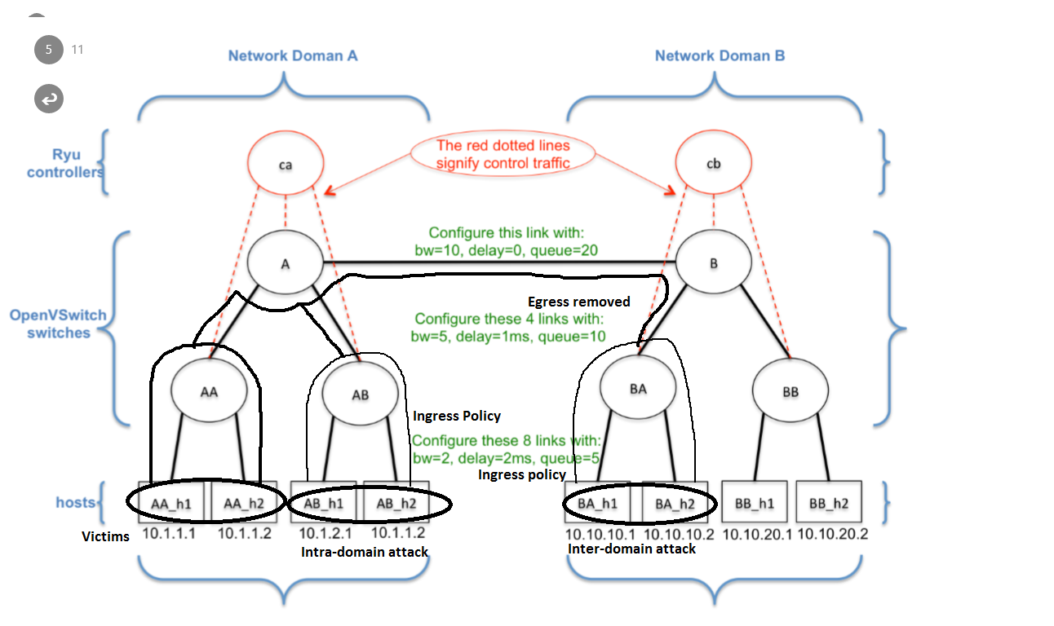
Solution – Ingress on pushback

Slide 11
Results

Slide 12
Evaluation

Slide 13
Conclusion

